Slide 6
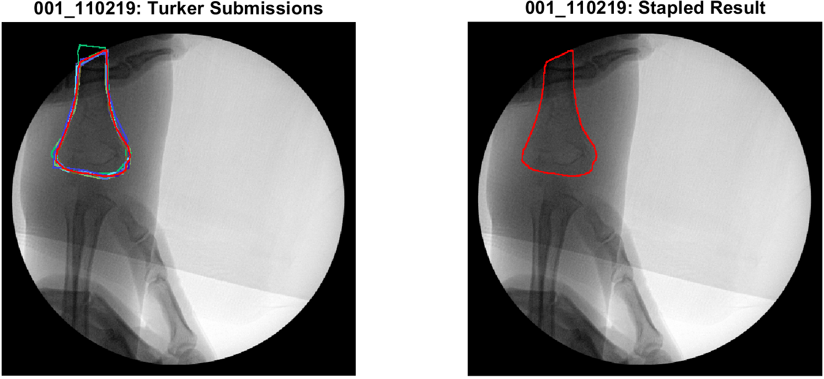

Slide 7
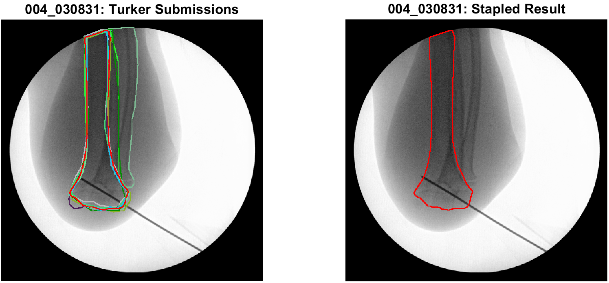

Slide 8
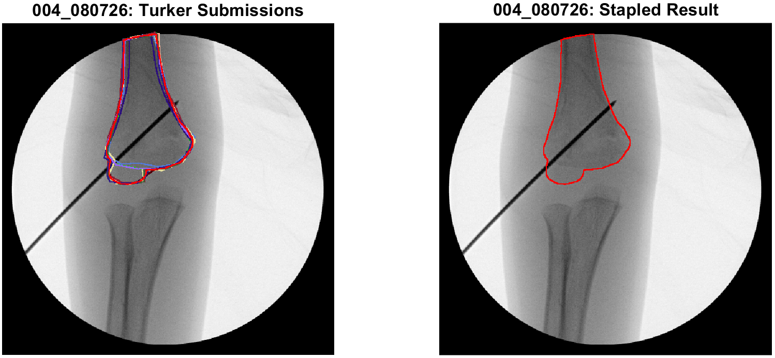

Slide 9
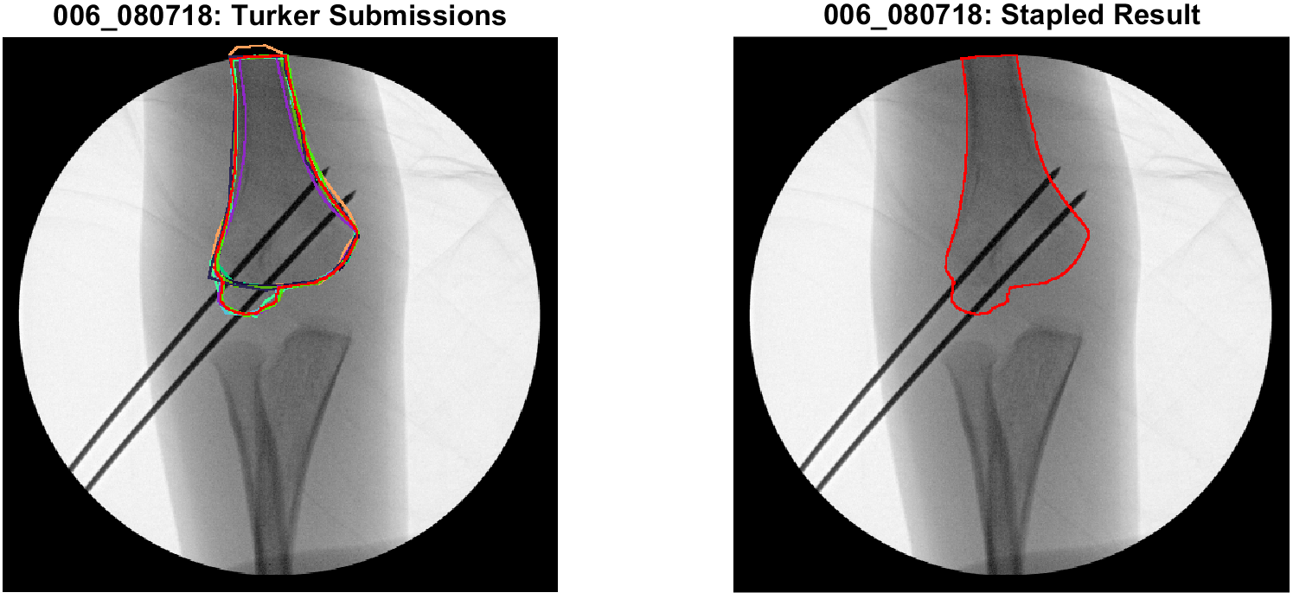

Slide 10
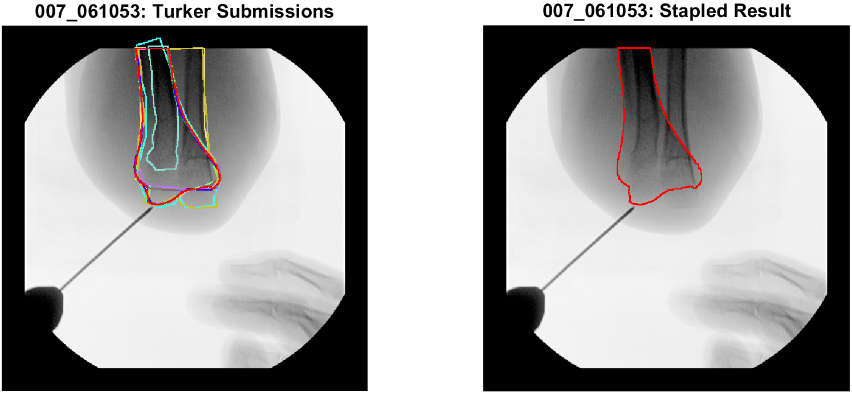

Slide 11
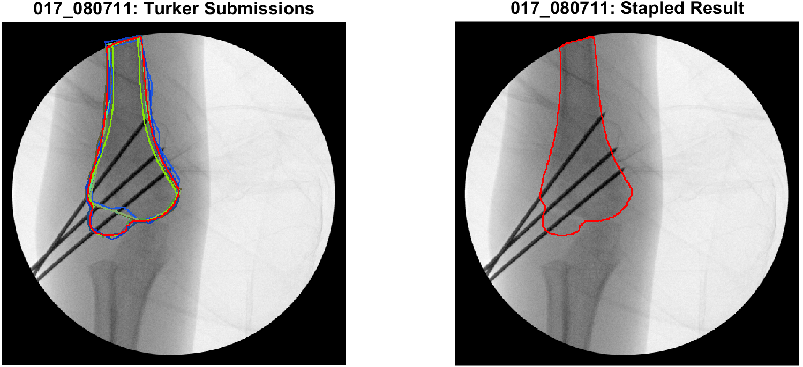

Slide 12
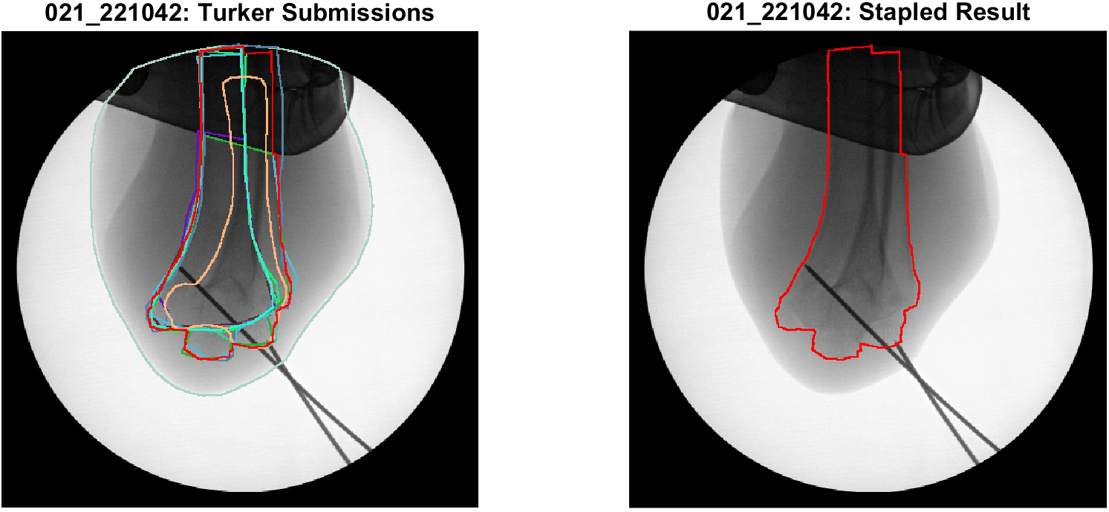

Slide 13
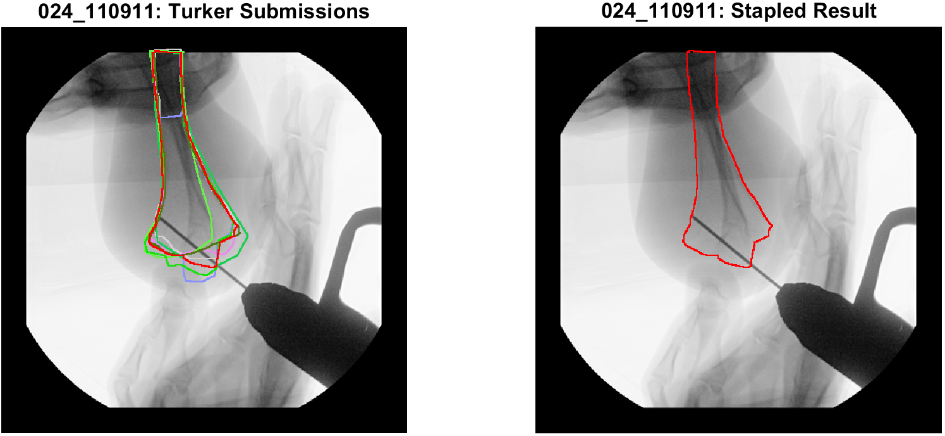
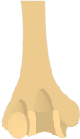

Slide 14
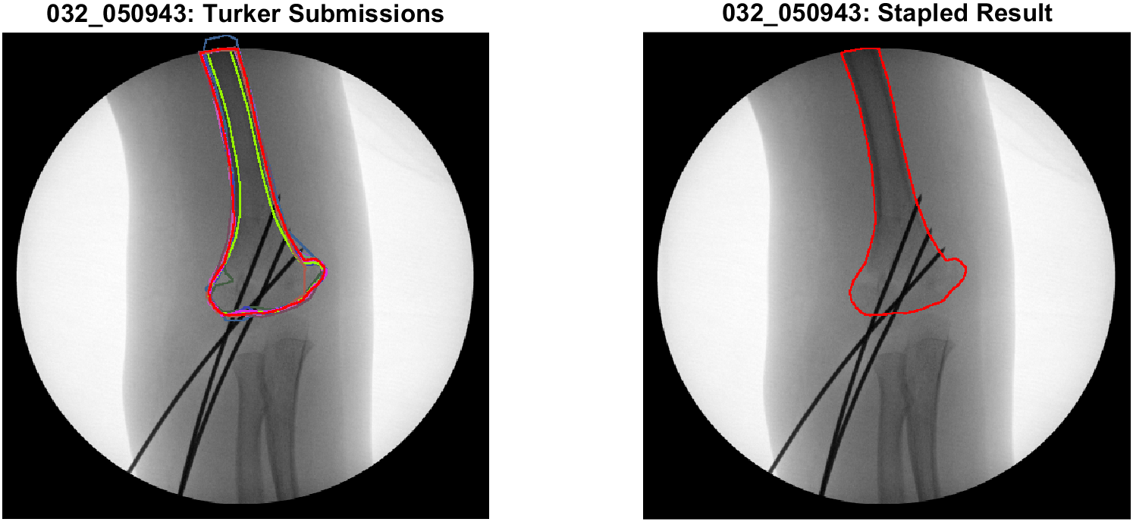

Slide 15
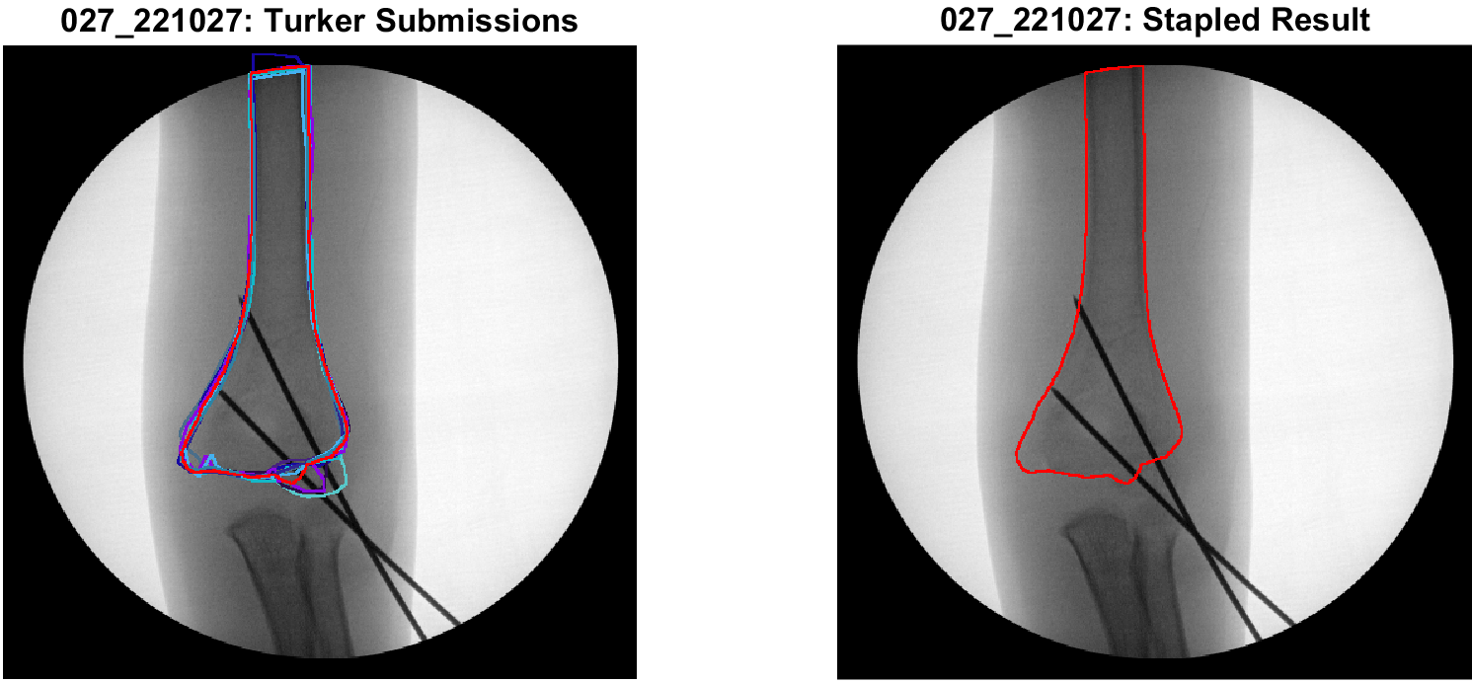

Slide 16
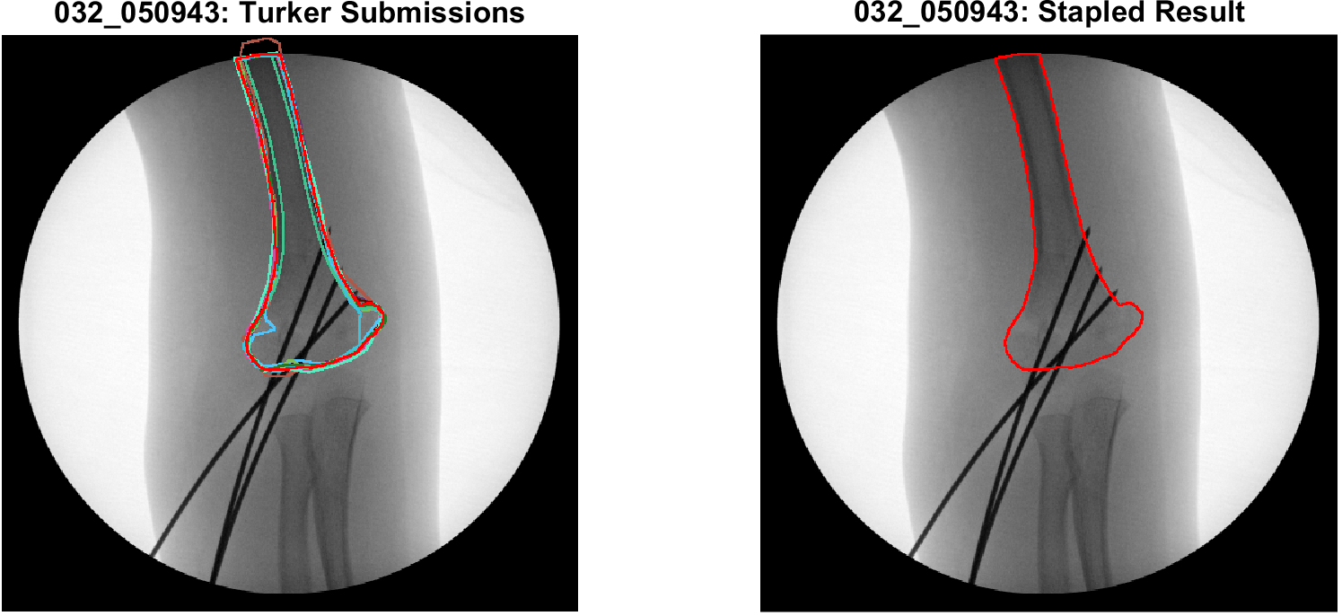

Slide 17
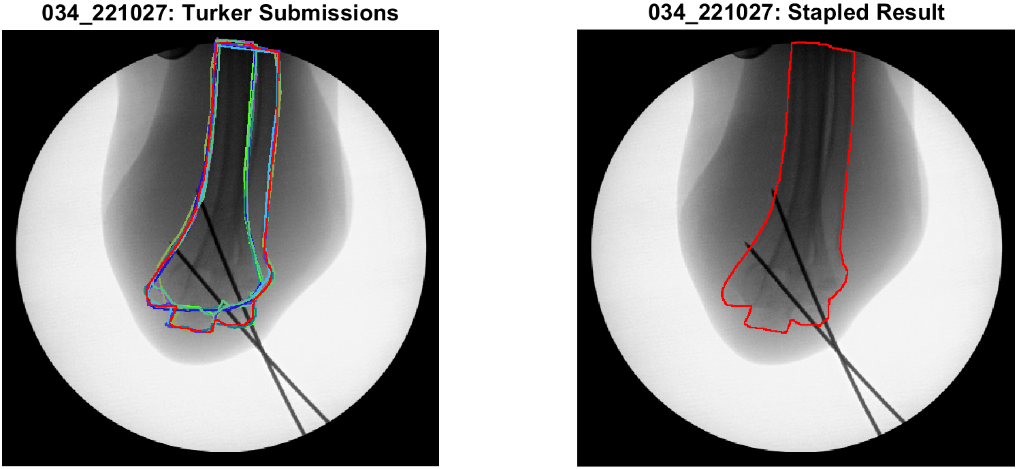

Slide 18
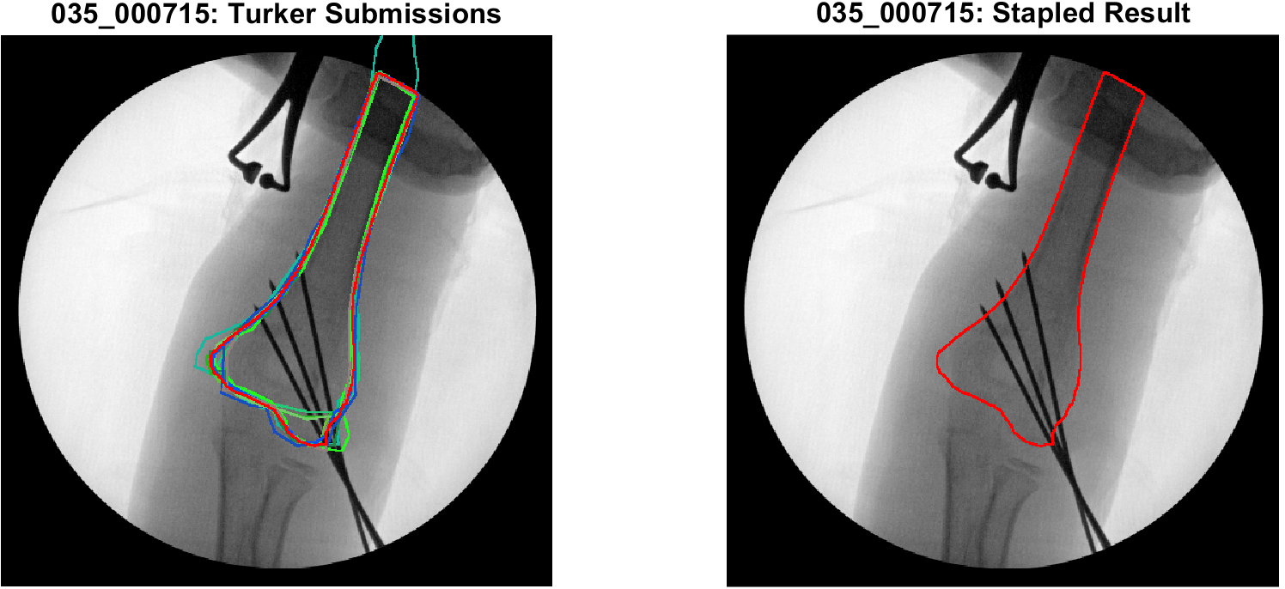

Slide 19
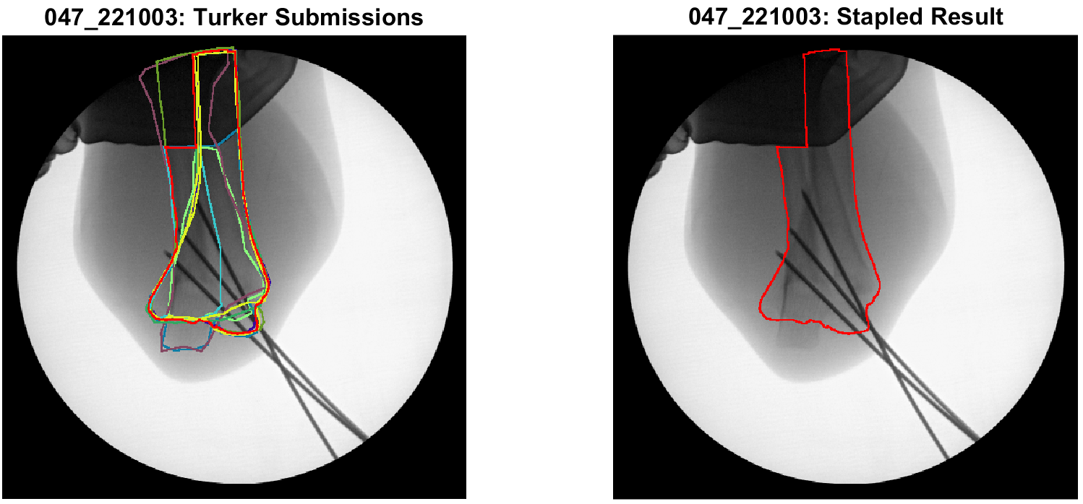

Slide 20
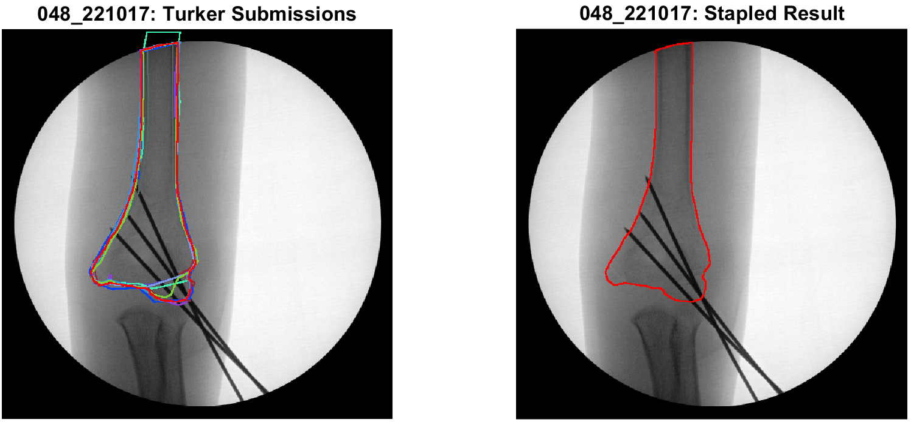

Slide 22
Bad instructions
- for overlapping ulna & radius
Correct image example that points at the radius (labeled in red)
Overlapping tool
Fish eye
Do not extrapolate
Analysis
Look at individual turker patterns
Monte carlo
Analysis to figure out how many turkers were needed
Look at the ones w syst biases and see if the staple algorithm would’ve worked
See if the problematic visual staple correlate with the stand outs of the box plot
To do
How many turkers we need each image
Need to figure out if we are using one or multiple instruction sets
How far can we push the one before they become too complicated and results aren’t getting better
Can we use these results to separate easy from difficult images
Then figure out another process for hard images

Slide 23
Analysis – Min # of Turkers
Compute STAPLE from all turkers for each image
Ground truth reference for each.
Identify all possible combinations of turker-submissions for each image.
E.g., [1 2], [1 3], …, [4 6 7 8 9], …, [1 2 3 4 5 6 7 8 9]
Compute partial composites for each combo of (2) for each image.
Include a range of tolerances, i.e., pixel-prob >= [0.5:0.05:0.95]
Compare similarity of (3) to (1)
Dice coef: [0.0 1.0]
Evaluate (4) as a function of numTurkers

Slide 24
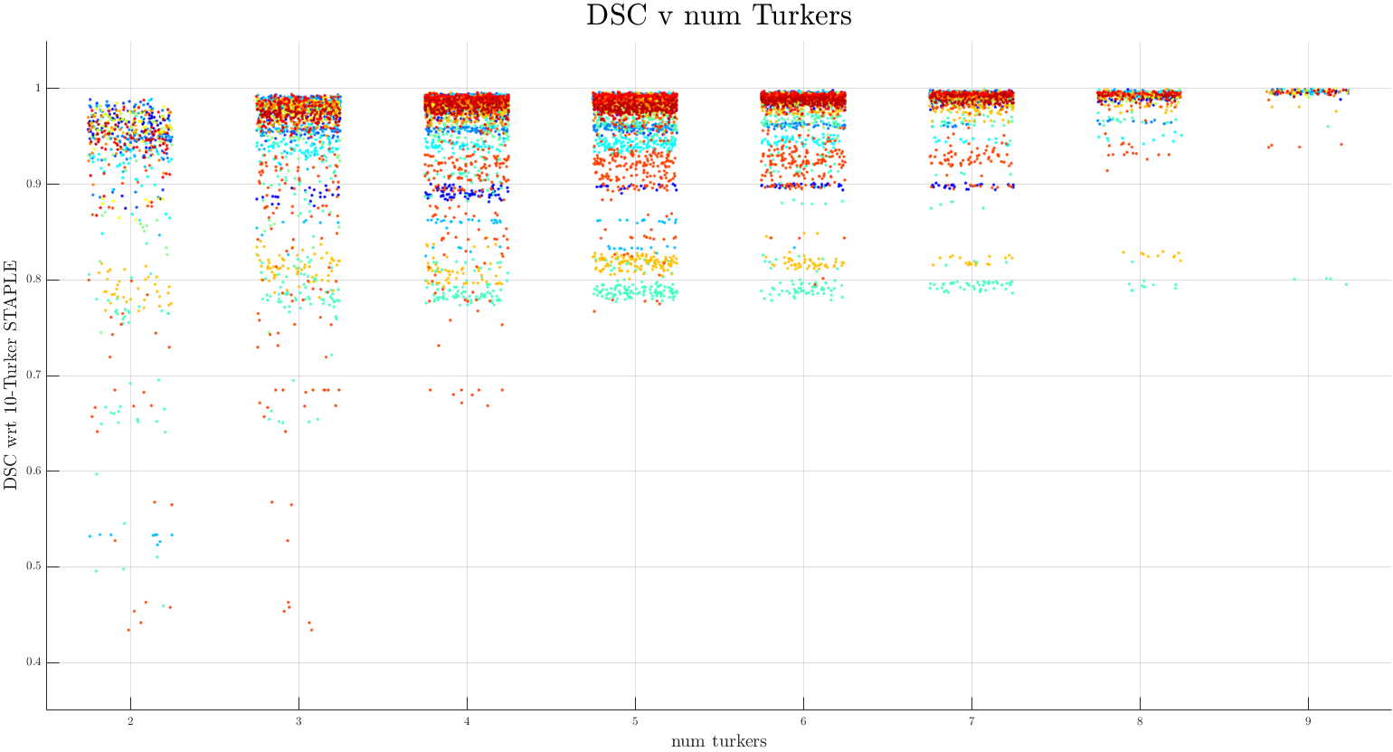

Slide 25
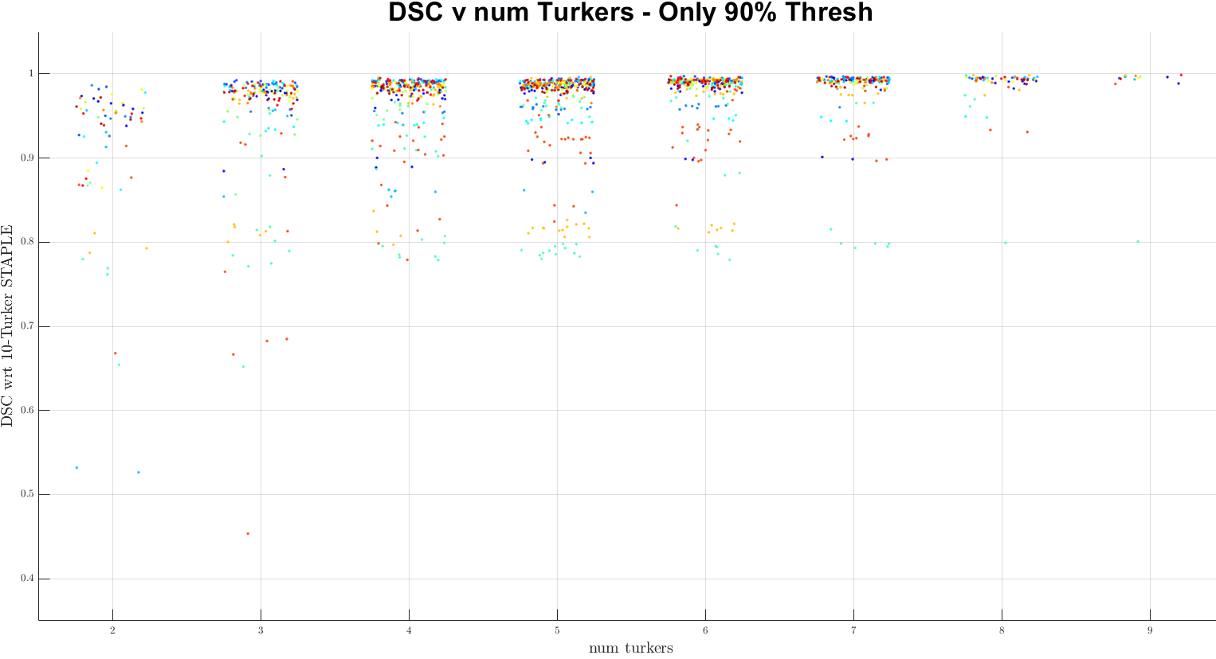

Slide 26
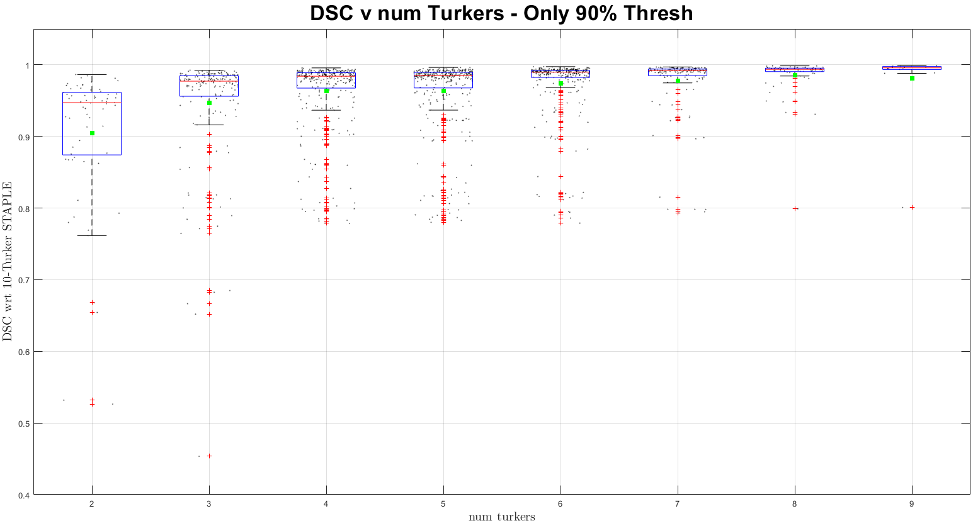

Slide 27
 |  |  |  |  | % Increase
#Turker | Mean | Median | dMean | dMedian | dMean | dMedian
2 | 0.9046 | 0.9471 | - | - | - | -
3 | 0.947 | 0.9771 | 0.042 | 0.030 | 4.7 | 3.2
4 | 0.9638 | 0.984 | 0.017 | 0.007 | 1.8 | 0.7
5 | 0.9637 | 0.9853 | 0.000 | 0.001 | 0.0 | 0.1
6 | 0.974 | 0.9897 | 0.010 | 0.004 | 1.1 | 0.4
7 | 0.9779 | 0.9917 | 0.004 | 0.002 | 0.4 | 0.2
8 | 0.9857 | 0.9936 | 0.008 | 0.002 | 0.8 | 0.2
9 | 0.9812 | 0.9958 | -0.005 | 0.002 | -0.5 | 0.2

